Slide 1
Study Design With emphasis on Reliability and Validity
Notes:
The slides are pretty bare, but the notes, links, and sources will be in the notes which you can check when the powerpoint is emailed.
I will ask for individual or have everyone participate in some parts.
I may call on people, to balance intro/extro version traits. Feel free to ‘pass’ it to the next person.

Slide 2
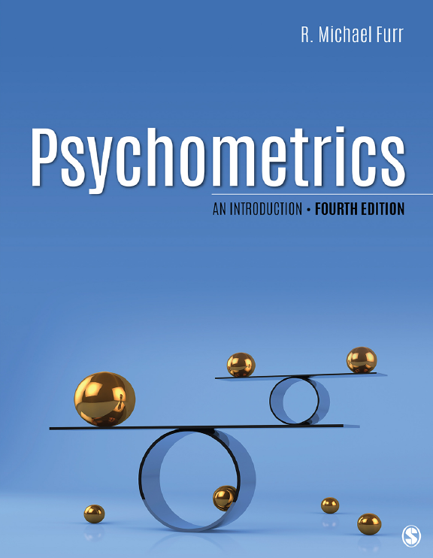
Notes:
I used this book and a few others sources for the majority of this presentation.
Motivation understanding Cronbach alpha

Slide 3
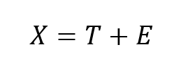
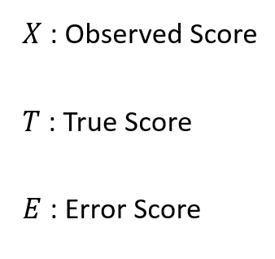
Classical Test Theory
Notes:
The centerpiece of classical test theory.
The observed score that is measured is a function of the true score and error score.
We assume there is a true score, and measurement error.
One of the important assumptions is that error is random and essentially cancels out over many measurements.
An interpretation of the true score is what we would see if our measuring instrument was infinitely precise, or the average score one would get with infinite measurements.

Slide 4

Notes:
GO ahead and write a number for the number of milliliters in this graduated cylinder.
----
Write down numbers on board.
Why do we have different scores? Is the measuring instrument precise? If we repeated the measure an infinite amount of times, would we get the true score?
---
Unfortunately the assumption of random error is not always held in real situations, directional bias present. But it’s an important theoretical model

Slide 5
Measuring Latent Constructs
Construct: Working Memory
Operational Definition: Number of items recalled
Notes:
We are interested in measuring latent constructs.
For example, one may be interested in measuring latent constructs.
Let’s say a researcher measures working memory using the number of items recalled.

Slide 6
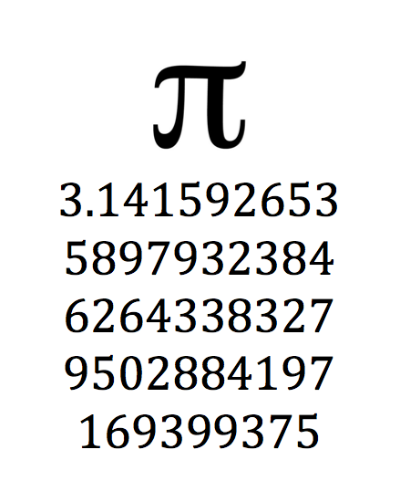
Memorize as many ‘items’ as you can
Notes:
Let’s try it. Attempt to memorize as many ‘items’ as you can in the image that shows up.
----
Count how many…then next slide
---

Slide 7
The number of items recalled reflects working memory.
Notes:
Is our operational definition: the number of items recalled, a good measure of working memory?
---
Issues: measurement error: sleep, focus, relationship with experimenter
Social desirability – don’t want to seem like a nerd so you put less digits , paid well for the study so you want to impress the researchers
Measuring another construct: Numerical fluency, mathematical knowledge, memorization ability
Are digits of a constant reflective of memorizing items?

Slide 8
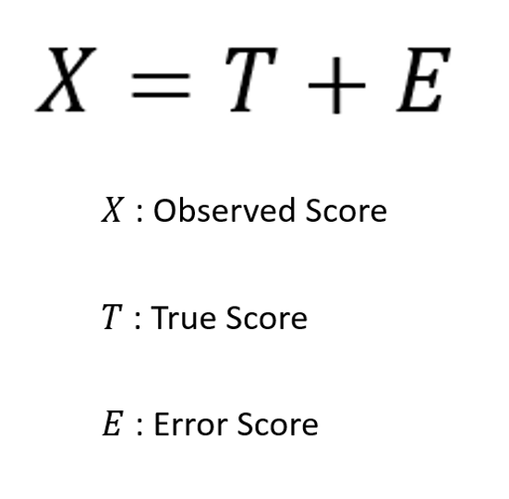
Sometimes the true score is MUCH different than the observed score for a measured construct.

Slide 9
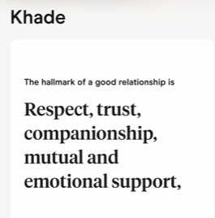
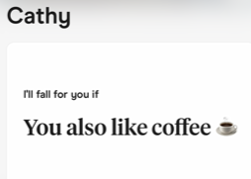

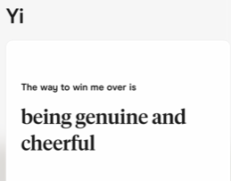
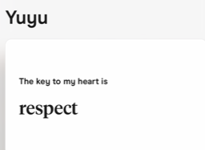
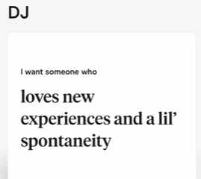
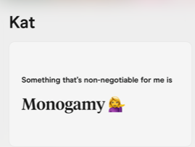
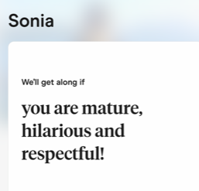
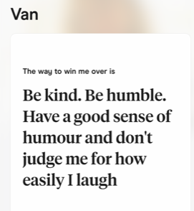
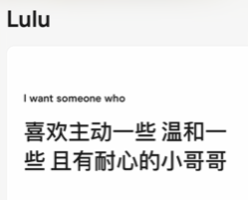
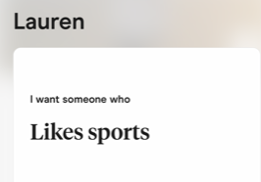
Notes:
Importance of measurement
On dating sites, usually women will get a lot of single men trying their best line… typically in response to one of these prompts
However, how is a woman’s measurement of companionship, respectfulness, love of coffee, likes sports, etc… psychometrically sound?
Lets say a sample of men strongly agree to certain constructs, what might be affecting their answer?

Slide 10

Significance of Psychological Measures
Notes:
Silly example
Life or death consequences
1978 Florida Freddie Lee Hall
IQ 71, 100 avg, 15 sd, lowest 2.5%
This case went all the way to the supreme court
5:4,
Justice: “...the rigid rule (70 iq cutoff), the court now holds, creates an unacceptable risk that persons with an intellectual disability will be executed, and thus is unconstitutional”

Slide 11
We are pleased that the majority of the court agreed that Florida’s use of a fixed IQ score cutoff to determine a defendant’s intellectual functioning is based on a fundamental misunderstanding of how to interpret IQ tests, said Nathalie Gilfoyle, JD, APA’s general counsel.
Notes:
What might have Gilfoyle meant by the statement?
----
Does IQ correlate strongly with intellectual disability
How is IQ related to the actions that Hall took?
Hall took 9 iq tests, with range of 60 to 80.

Slide 12
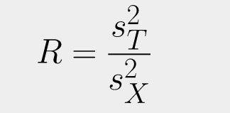
Reliability
Reliability is the extent to which the differences in respondents’ test scores are a function of their true psychological differences, as opposed to measurement error
Notes:
We’ll be exploring two major concepts: reliability and validity
Starting with Reliability, some theoretical background
What this basically implies is that we want measurement error to be relatively low
..
Mathematically, it is how much variance of the observed scores we can attribute to the true score

Slide 13

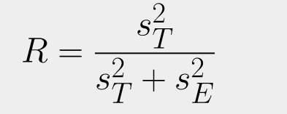

Notes:
Now, what does that exactly mean?
If we take the key equation we started with, we can rewrite the reliability equation.
Here we can infer that if the variance in error scores is low, reliability will approach 1.
We can also abstract the equation to be a ratio involving signal and noise.

Slide 14
Notes:
Now what exactly is signal and noise?
Noise, mentioned earlier, implies measurement error.
Without me saying anything, what are some ways we can increase signal and reduce noise?
---
Signal refers to the variance in test scores, which can be increased by items that are more discriminatory.
For example, an item that measures if you are male or female (binomial) will have much more variance than one that measures intelligence (normally distributed)
We can also increase items to increase variance.
We can reduce noise by making sure tests are done in similar locations, reducing testing fatigue, etc.
….now there is a lurking problem with these equations…

Slide 15
Notes:
Now what exactly is signal and noise?
Noise, mentioned earlier, implies measurement error.
Without me saying anything, what are some ways we can increase signal and reduce noise?
---
Signal refers to the variance in test scores, which can be increased by items that are more discriminatory.
For example, an item that measures if you are male or female (binomial) will have much more variance than one that measures intelligence (normally distributed)
We can also increase items to increase variance.
We can reduce noise by making sure tests are done in similar locations, reducing testing fatigue, etc.
….now there is a lurking problem with these equations and in obtaining reliability… what’s the problem?
----
We can never know the true test score

Slide 16
Measuring Consistency as an Estimate of Reliability
Are you inclined to keep in the background on social occasions?
Are you inclined to limit your acquaintances to a select few?
Can you usually let yourself go and have a good time at a party?
Notes:
Typically, what we will use is internal consistency as an estimate of reliability.
We measure the scores for a group at one setting and remeasure them for the same group.
The higher the correlation between test scores, the greater the reliability.
For example, we can have an individual take a test (3 items) and retake the test at another time.
What’s the problem?
---
Carryover effects
Growth, development, learning

Slide 17
Are you inclined to keep in the background on social occasions?
A
Are you inclined to limit your acquaintances to a select few?
Can you usually let yourself go and have a good time at a party?
Do you usually take the initiative in making new friends?
B
Do you like to play pranks upon others?
Do you derive more satisfaction from social activities than from anything else?
Notes:
one way to fix this is to have alternate forms to reduce these effects,
Individuals can take two different tests at two sittings, to reduce carryover effects
but we have new problems emerge…
---
How do we know that the two tests are measuring the same thing (also known as parallel tests)
We can avoid carryover effects by testing groups only once

Slide 18
A
Are you inclined to keep in the background on social occasions?
B
Are you inclined to limit your acquaintances to a select few?
A
Can you usually let yourself go and have a good time at a party?
B
Do you usually take the initiative in making new friends?
A
Do you like to play pranks upon others?
B
Do you derive more satisfaction from social activities than from anything else?
Notes:
The split forms approach, such as breaking a test into odd and even items
However, we still have some problems…
----
The two forms may not be the same depending on how you break it.
The internal consistency can be improved further.

Slide 19
A
Are you inclined to keep in the background on social occasions?
B
Are you inclined to limit your acquaintances to a select few?
C
Can you usually let yourself go and have a good time at a party?
D
Do you usually take the initiative in making new friends?
E
Do you like to play pranks upon others?
F
Do you derive more satisfaction from social activities than from anything else?
Notes:
We assume each item is its own separate test.
We check the correlations between each ‘item/test’ for reliability.
This brings us to the commonly used measure of reliability, alpha.

Slide 20
Mind-Wandering Scale
"Our mental life, like a bird's life, seems to be made of an alternation of flights and perchings." James, William (1842-1910)
The ‘flights’ and ‘perchings’ of our thought, so poetically described by William James, are as mysterious to us as they are intimately familiar. To James, a perching represented a mental state including contents such as imaginings, worries and inner speech, whereas a flight represented the ‘movement’ from one mental state to another.
A recent theoretical review defines mind-wandering as a “shift in the contents of thought away from an ongoing task and/or from events in the external environment”. This prominent definition regards mind-wandering as a type of thought characterized by its contents (or, in William James’s terms, the bird’s perchings rather than its flights).
I have difficulty maintaining focus on simple or repetitive work.
Notes:
I would like us to develop a scale for mind-wandering so we can investigate reliability.
Here is a group of descriptions I like.
Each person please think of an item and write it down. We will use the 5-point Likert scale (strongly disagree to strongly agree)
----
Put items on google sheets, including a fake one

Slide 21

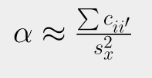
Cronbach’s Alpha as an estimate of reliability
Notes:
The equation for Cronbach’s alpha isn’t too bad.
With enough items, the left term approaches 1 and the right term is what's left.
--- write on board the value of k

Slide 22


Sum of pairwise covariances
Variance of test scores
Notes:
Basically the ratio of pairwise covariance to variance.
Pairwise covariance can be thought of how strongly the scores of the items relate to each other.
We expect this to be large if all of the items reflect the mind wandering construct.
In other words, our multiple ‘tests’ of mind wandering are strongly correlated.
----- finish google sheets, discuss items ( next slide)

Slide 23
Problem ‘items’ or ‘tests’ that reduce reliability
Items do not measure the same construct
Items are heavily affected by measurement error
Notes:
One thing that we should emphasize is that reliability is an equation for a set of test scores, and not the measurement tool itself.
We would not call our mind-wandering scale reliable, but the scores obtained can show reliability.
Scores can be improved by dropping ‘tests’ that do not measure the same construct or may suffer from too much measurement error.
----drop items to see new Cronbach alpha value

Slide 24
Reliability: How much of the total variance is explained by the covariance?
Notes:
Cronbach alpha’s value implies that a higher reliability means that the variance in the test scores can be explained by the covariance (or strength of the relationships between the items)
A higher reliability value implies a strong signal and low noise.

Slide 25
High reliability implies you are measuring the signal and not the noise
Notes:
less attenuated, more accurate effect sizes (reduced confidence interval width)
Smaller p-value, likelier statistical significance

Slide 26
Validity
Construct validity
Content validity
Face validity
Internal validity
External validity
Response process validity
Predictive validity
Associative validity
Convergent validity
Criterion validity
Concurrent validity
Discriminant validity
Ecological validity
Differential validity
Statistical conclusion validity
Manipulation validity
Instrumentation validity
Diagnostic validity
Cultural validity
Validity validity
Construct-irrelevant variance validity
Sensitivity validity
Stability validity
Transfer validity
Notes:
In researching validity I found quite a few terms..
Whereas there are quantitative approaches to measuring reliability, I found that validity was a bit tougher to put into equations.
So we’ll use some examples to demonstrate the importance of validity.

Slide 27
Validity
colorquiz
The degree to which evidence and theory support the interpretations of test scores for proposed uses.
Notes:
Read home
Ask for volunteer
---
Read about the quiz
Colorquiz like fortune cookies
Validity is the degree of which a test measures what it is supposed to measure.
Worded differently, it is the degree to which evidence and theory support the interpretations of test scores for proposed uses.

Slide 28
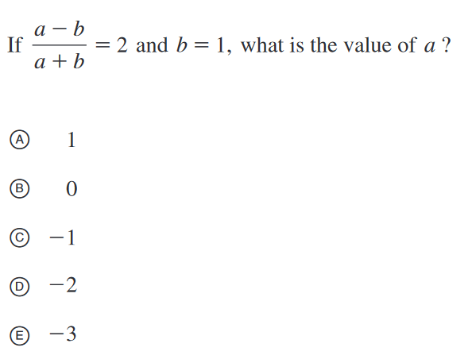
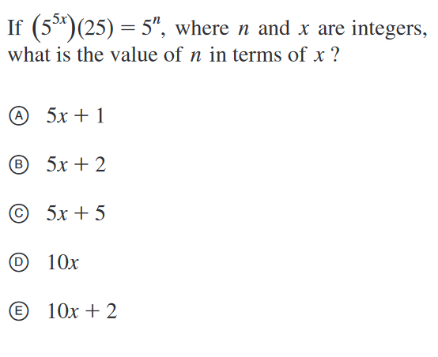
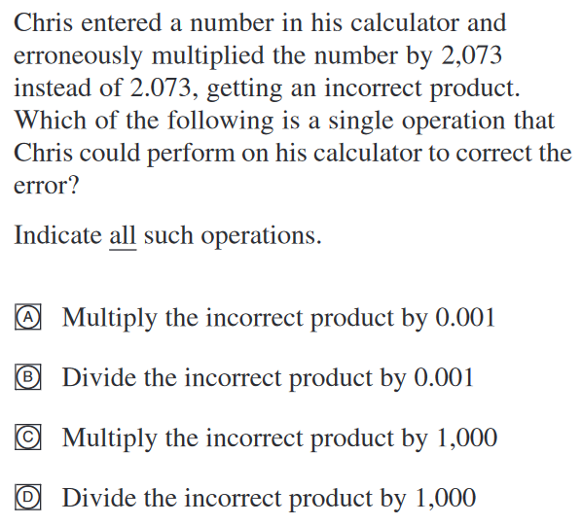
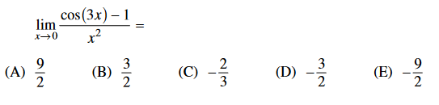

Math Test
Notes:
Self-grade, don’t show.
What might be the problem of this test?
---

Slide 29
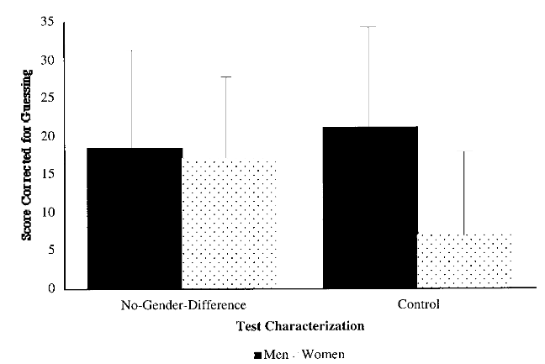
Are men better than women at math?
Notes:
Vote – do you think males or females scored better on the test
https://doi.org/10.1006/jesp.1998.1373
https://www.science.org/doi/epdf/10.1126/science.1154094
In no gender difference, women were told that men and women performed equally on this test
So this is an example of construct validity.
For example, the males’ responses to the test might be determined primarily by a
single construct—mathematical ability—but the females’ responses might be
determined by two constructs—mathematical ability and stereotype threat

Slide 30
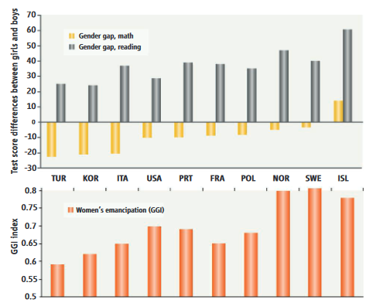
Notes:
Relationship between women’s emancipation in a country and test differences between girls and boys.
Gender gap index

Slide 31
Igret eert owns twcih nadcy yanr
noise
Notes:
https://www.youtube.com/watch?v=Lx4k-0RFaaQ

Slide 32
Cklco olbeg atpe ntaip aledm plpea

Slide 33
Does control deprivation reduce cognitive abilities?
Notes:
What do you think…which group unscrambled more words?
----
Researchers found that both groups unscrambled approximately the same number of words.
However, they found that the 2nd group ignored the directions more, and jumped around more.
So what does this mean for the research?
----
Response process validity: the extent to which the actions and thought processes of individuals match what the researchers think

Slide 34
Bias and experimental design
Heuristic bias
Social desirability bias
Rosy retrospection
Novelty bias
Participant burden/retention
Sampling bias
Observer bias
Confirmation bias
Measurement bias (alias of construct bias)
Internal Bias
Recall bias
Participant reactivity
Response shift
Test bias
Predictive bias
External bias
Framing
One final experiment….
Notes:
For me, participant bias and experimental design are very important, in addition to validity and reliability
Two individuals take control and exp. 1
Remind everyone to not distract participant for the length of the study. User can browse normally.
---discuss problems with experiment….
Framing of questions: are you mind-wandering vs are you on task
Response bias – participant has another idea of what mind-wandering is
Avoid mind wandering as specific videos
Mind wander at specific videos (racism, politically correct, controversial)
Video randomization important
Researchers watching?
Novelty bias
Ecological validity (does this match what users would typically do) – have them sit comfortably, use their own phones (but then phone type can be a treatment)
Recall bias – does not remember for longer sessions
1-5 scale individuals avoid extreme answers

